Slide 1
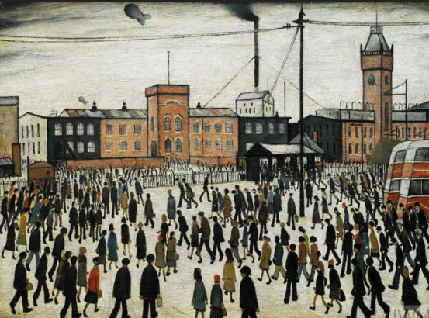
PE:
As well-rounded, active citizens, our children will feel a sense of belonging by immersing themselves in a wide range of physical activities. This term, our sessions will be guided by an external PE provider, and they will take place on Friday. We will be creating dance routines and net and wall games with a focus on badminton.
Forest School:
We are extremely fortunate to be able to access provision for outdoor learning which can increase a child's confidence and self-esteem through exploration, problem solving, and being encouraged to learn how to assess and take appropriate risks depending on their environment. Please ensure children come to school with appropriate clothing and footwear for these sessions on Wednesdays.
Art & Design:
As artists, we will be learning about the work of L.S Lowry. We will explore Lowry’s exploration of community and the balance between life and work. We will examine the techniques Lowry used to create his works and his placement within the artistic world at the time of the painting and beyond.
Science:
As scientists, the children will carry out a variety of experiments to understand that we see things because of light travelling between light sources and our eyes. They will explore how light travels in straight lines and that we see objects because they give out or reflect light into our eyes. They will use the idea of light travelling in straight lines to explain why objects and shadows of objects are the same shape.
Maths:
As mathematicians Year 4 will firstly be continuing with multiplication & division, we will then move onto area, length & perimeter, after that we will explore fractions and will end the term learning about mass & capacity. Year 5 & 6 will be continue exploring fractions, then shall revisit multiplication and division, we will next move onto decimals, then finish off Spring Term learning about area, perimeter and volume.
Croft Class
Spring 2025
Music:
In Music we will explore the theme of protest songs through the song Something Inside (so strong). British songwriter Labi Siffre composed the song in 1987, inspired by the injustice of South Africa’s system of racial apartheid. Protest songs have been sung around the world for centuries, calling for social change and shining a light on injustice. We will also have whole class music lessons.
RHE:
As responsible citizens living in the wider world, we will learn that education is a human right and why this is important. We will think about how we care for others and our responsibility to care for things and people around us. We will also discuss what prejudice and discrimination are and why and how they should be challenged.
History and Geography:
As Historians, we will immerse ourselves in the prehistoric world, exploring and questioning how palaeontologists and archaeologists find out what the world was like millions of years ago. We will discover and explore dinosaurs, early man and Ice Age animals, as well as investigating what life was like in Britain from the Stone Age to the Iron Age.
As Geographers, we will explore the Northern and Southern hemispheres as well as the Equator, an imaginary line which circles around the Earth, halfway between the North and South Poles. We will explore the concept of time zones, learning why time varies across different parts of the world and discover the regions of the Arctic and the Antarctic, finding similarities and differences between them.
RE:
This term, the children will identify some beliefs about God in Islam, expressed in Surah 1. They will also make clear links between beliefs about God and ibadah (worship) and how this links to prayer, fasting, celebrating and the intention to live out the five pillars of Islam.
Christian Distinctiveness:
We demonstrate our Christian Values through daily acts of collective worship, singing worship and family group acts of worship.
English:
As writers, our learning will be underpinned by the purpose of writing ‘to inform’. We will immerse ourselves into a variety of different informative texts with a non – chronological report as our main writing outcome. We will develop our understanding of how a report is written. In class, we will be using our DERIC (decode, explain, retrieve, infer and choice) reading skills to retrieve information and answer questions related to our class novel 'Stig of the Dump'.

